Slide 1

D1 20W Kit
USER MANUAL
Version 1.1 • Feb 2025
The picture is for reference only,the actual product shall prevail

Slide 2
Blank page

Slide 3
Contents
Part 1: Packing List
Part 2: Mechanical Assembly
Part 3: Usage Tips
Part 4: Maintenance
xGantry

Slide 4
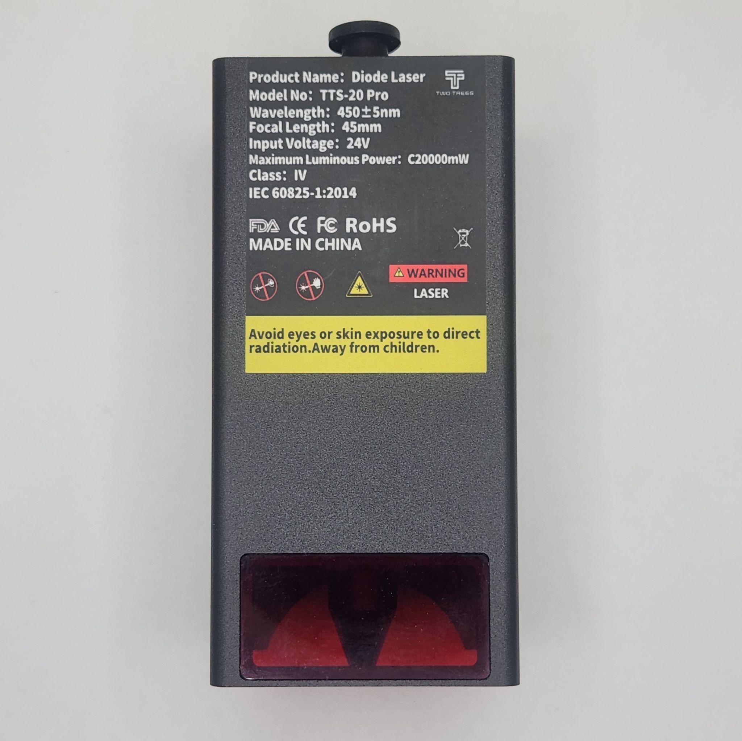
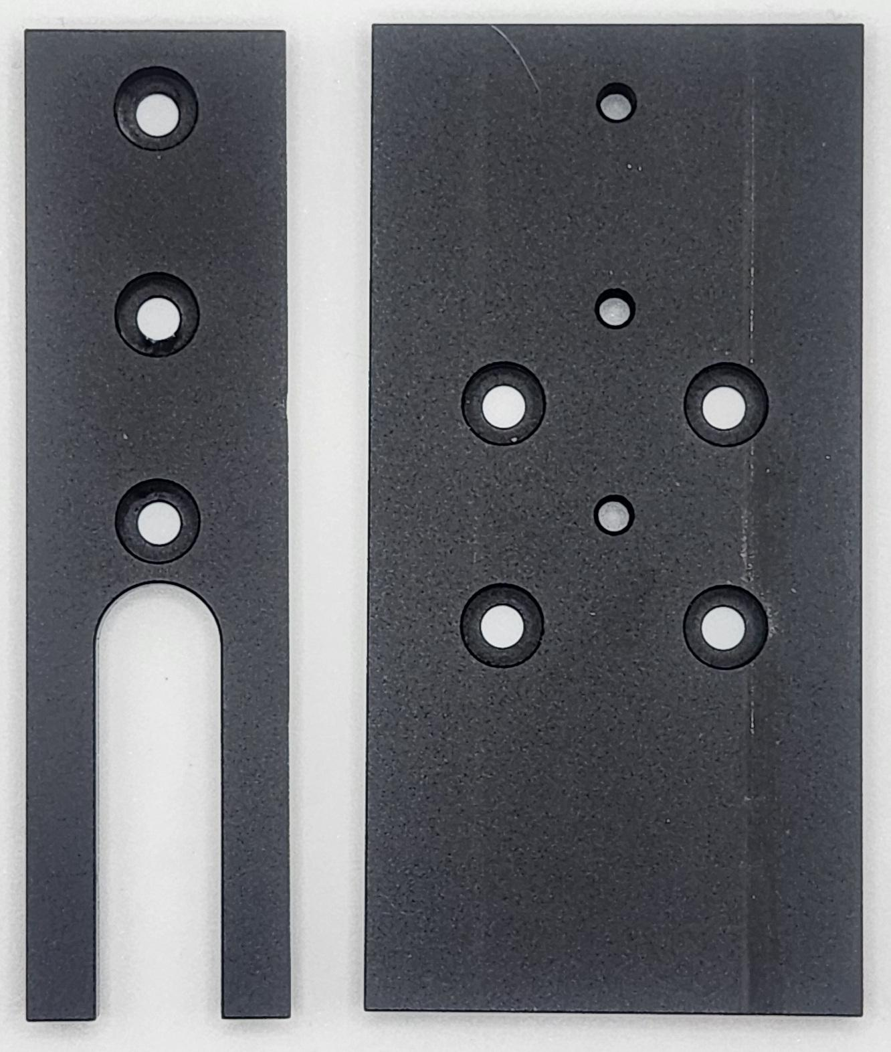
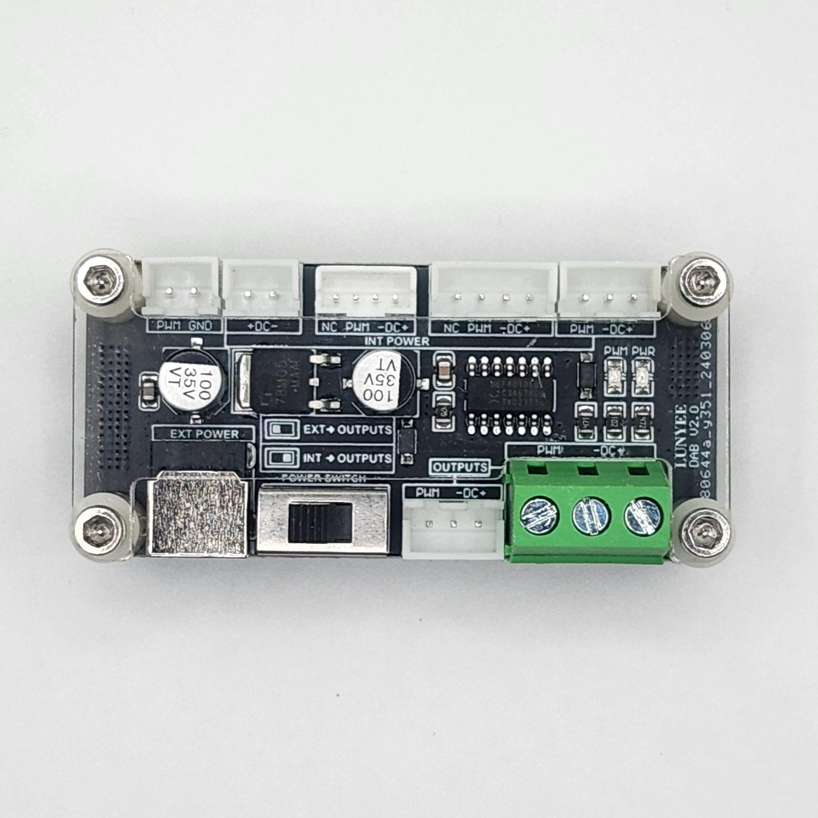
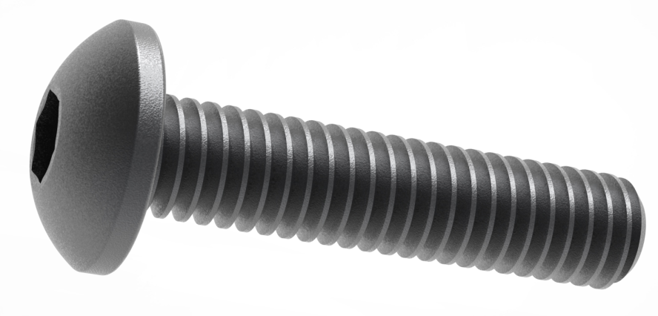
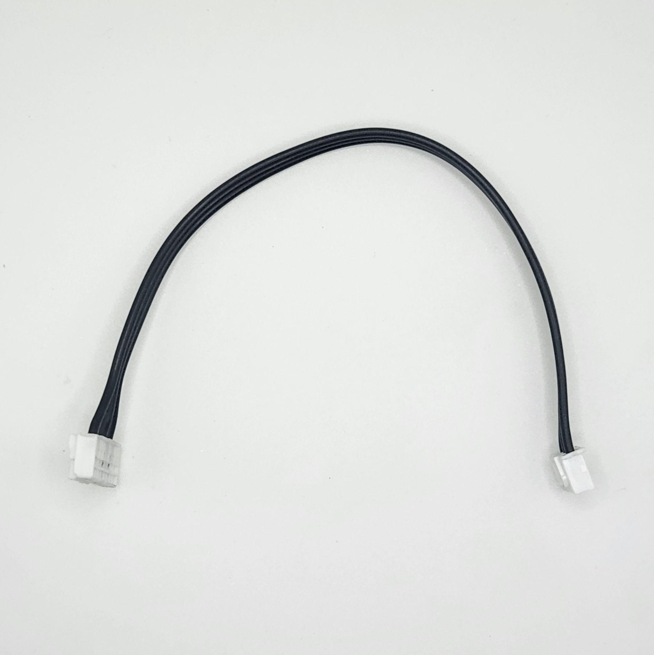
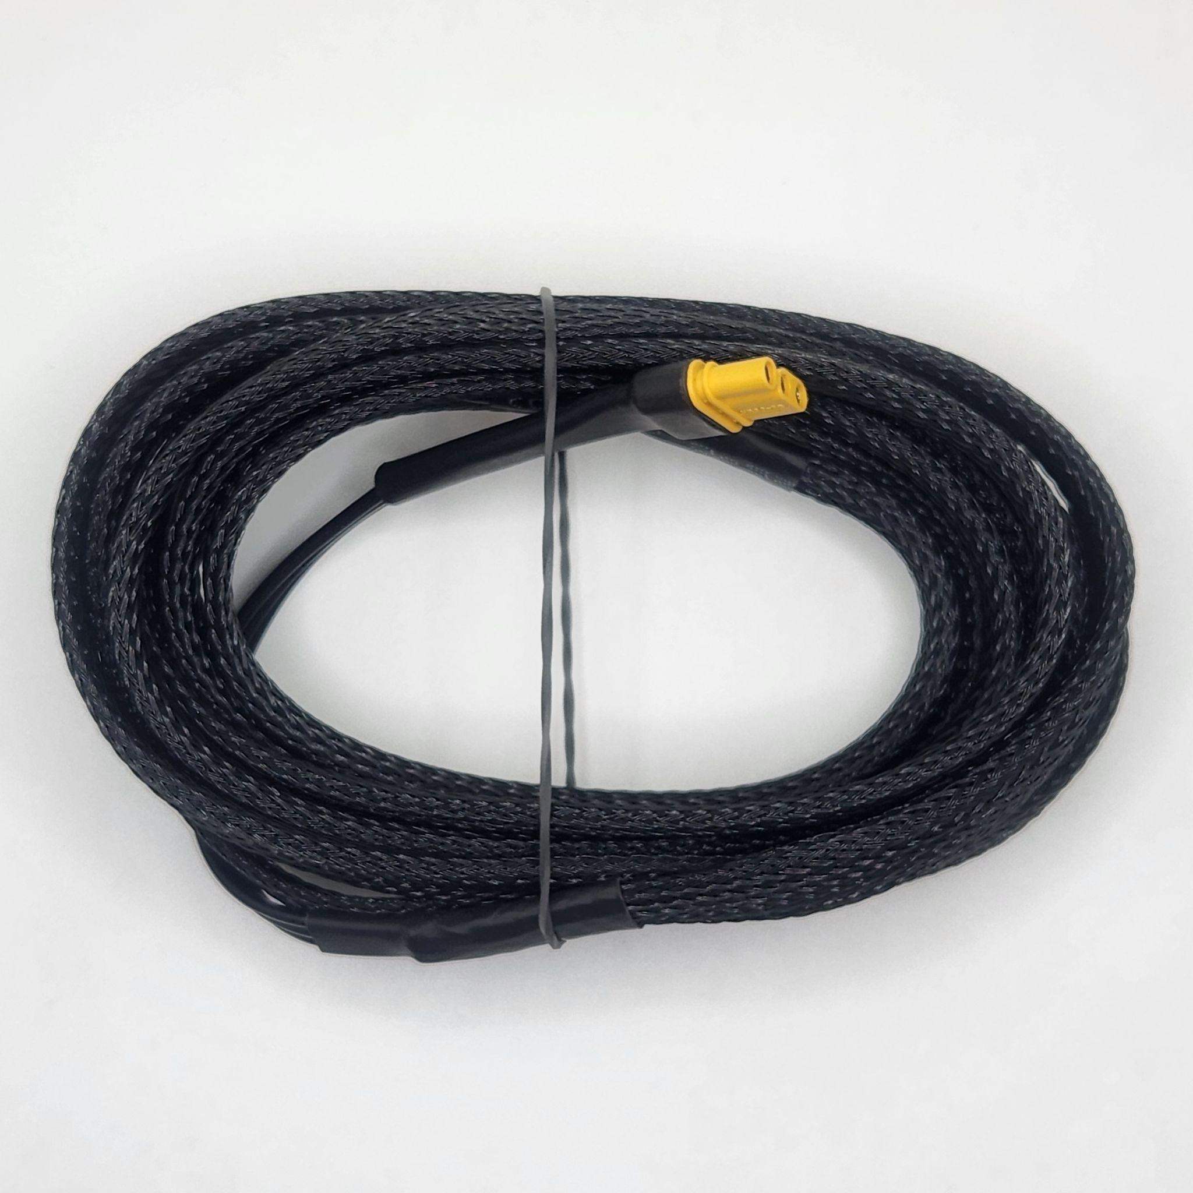
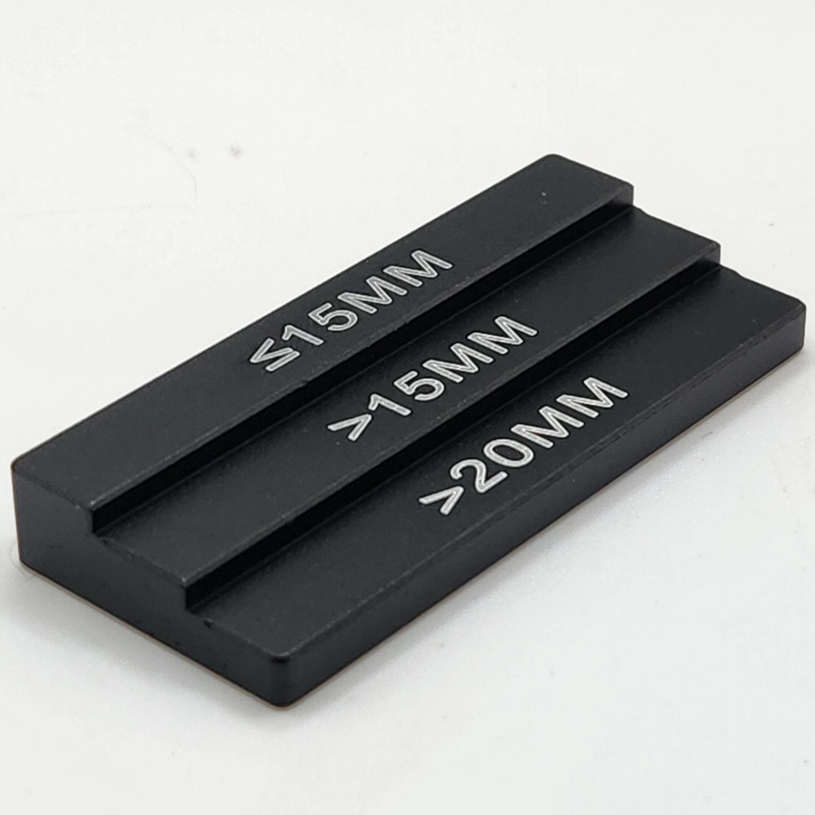
Part 1
Packing List
Laser Module
Dovetail Parts
Adapter Board
Screw M3x4mm x7
Adapter Cable
Module Cable
Focus Block

Slide 5
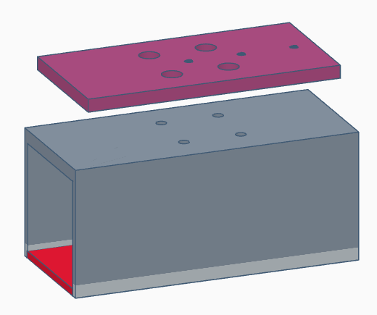
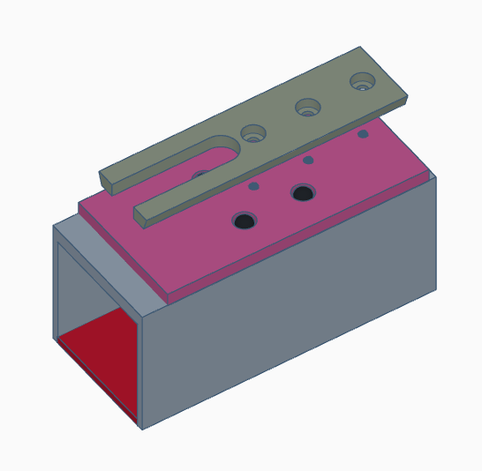
Part 2
Mechanical Assembly
Step 1
Parts Required:
------Laser Module
------Dovetail Part
------Screw M3x4 x7
------Right Adapter Plate
Assemble lower Dovetail Part with Laser Module using M3x4 x4 screws
Assemble Upper Dovetail part with lower Dovetail Part using M3x4 x3 screws
Note: Be careful to match the alignment of both Dovetail Parts in relation to the module. Screw heads should not protrude from Dovetail Parts
Module is now ready to be mounted to your machine as usual

Slide 6
Part 2
Mechanical Assembly
Step 2
Parts Required:
------Adapter Board
------Adapter Cable
------Module Cable
Connect one end of the Adapter Cable to the Adapter Board and the other the D1 control board
Connect Module Cable to Adapter Board
Make sure switch is to the right, INT->OUTPUTS

Slide 7
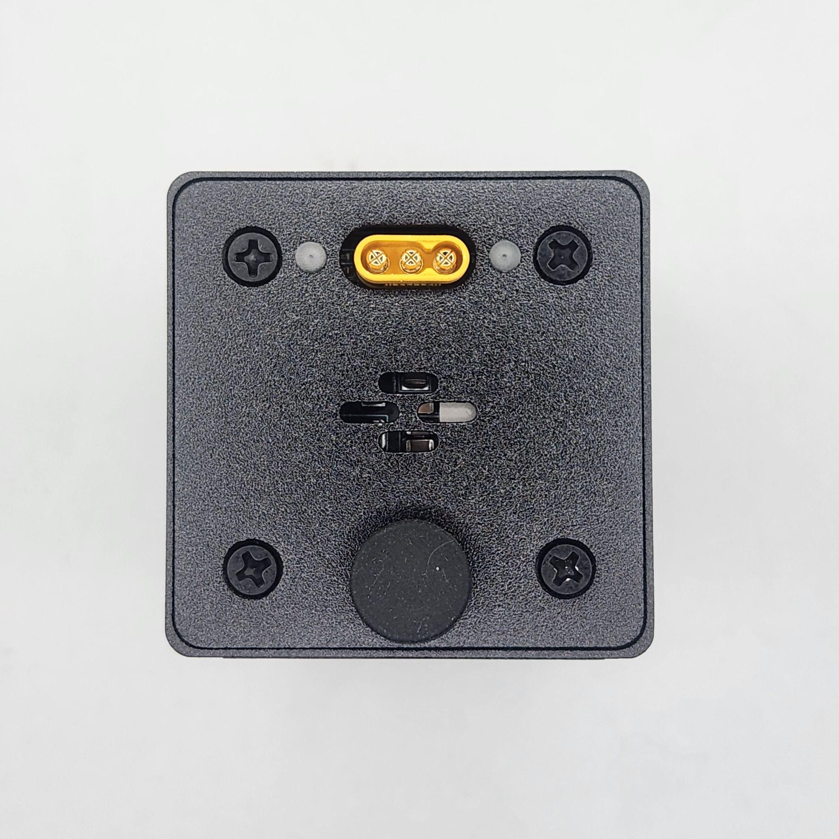
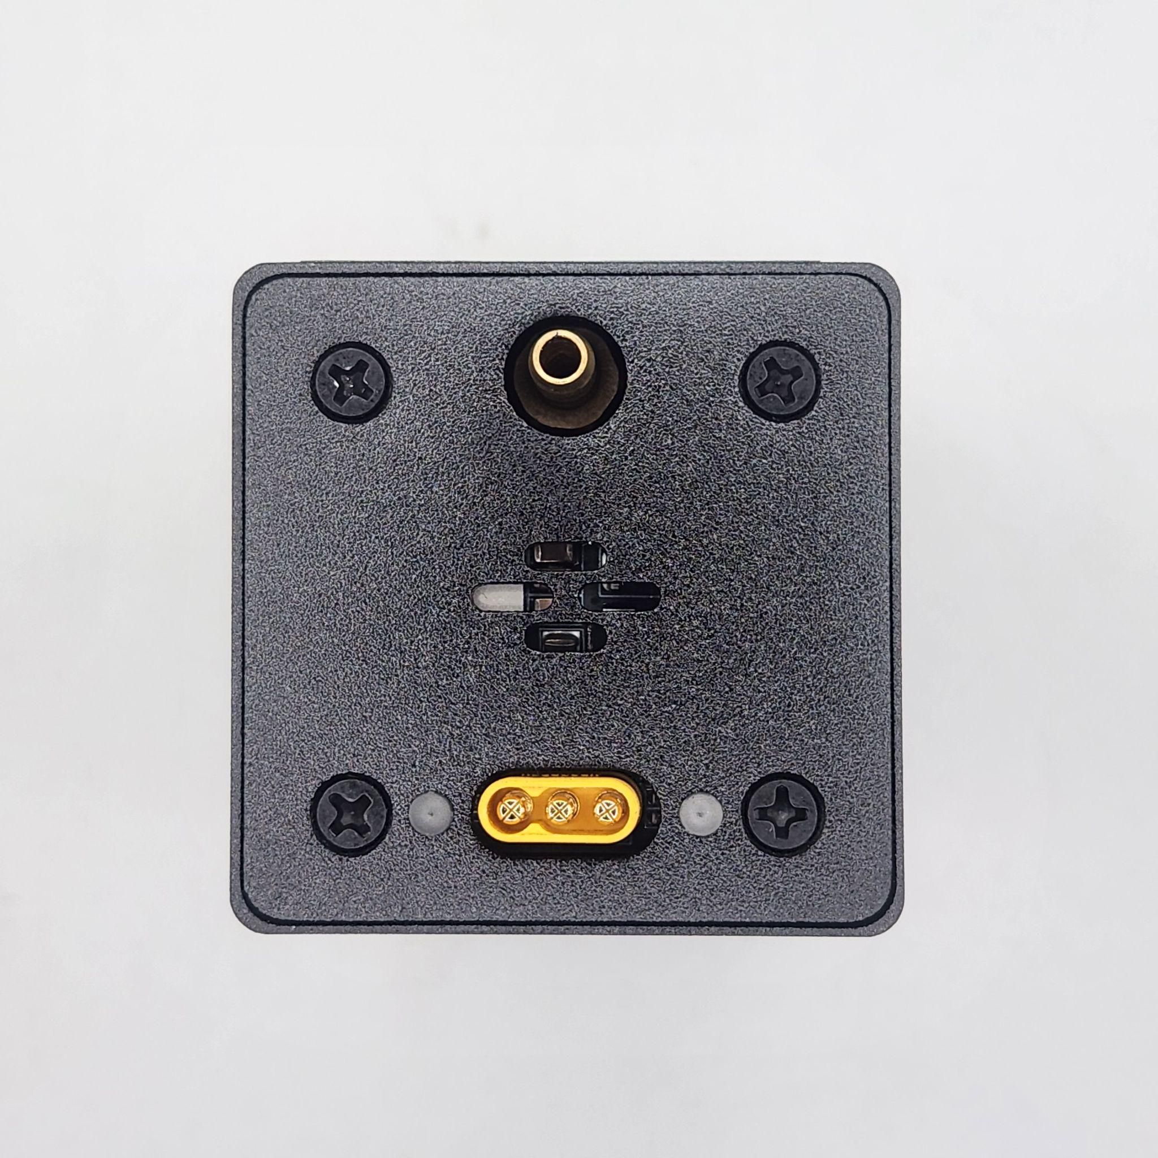
Part 2
Mechanical Assembly
Step 3
Parts Required:
------Laser Module
------Module Cable
------M5x12 Screw x8
------Profile Nut x8
Connect Module Cable to Laser Module (it only fits one way)
If you have air assist, remove the cap and connect the air tube to the Laser Module

Slide 8
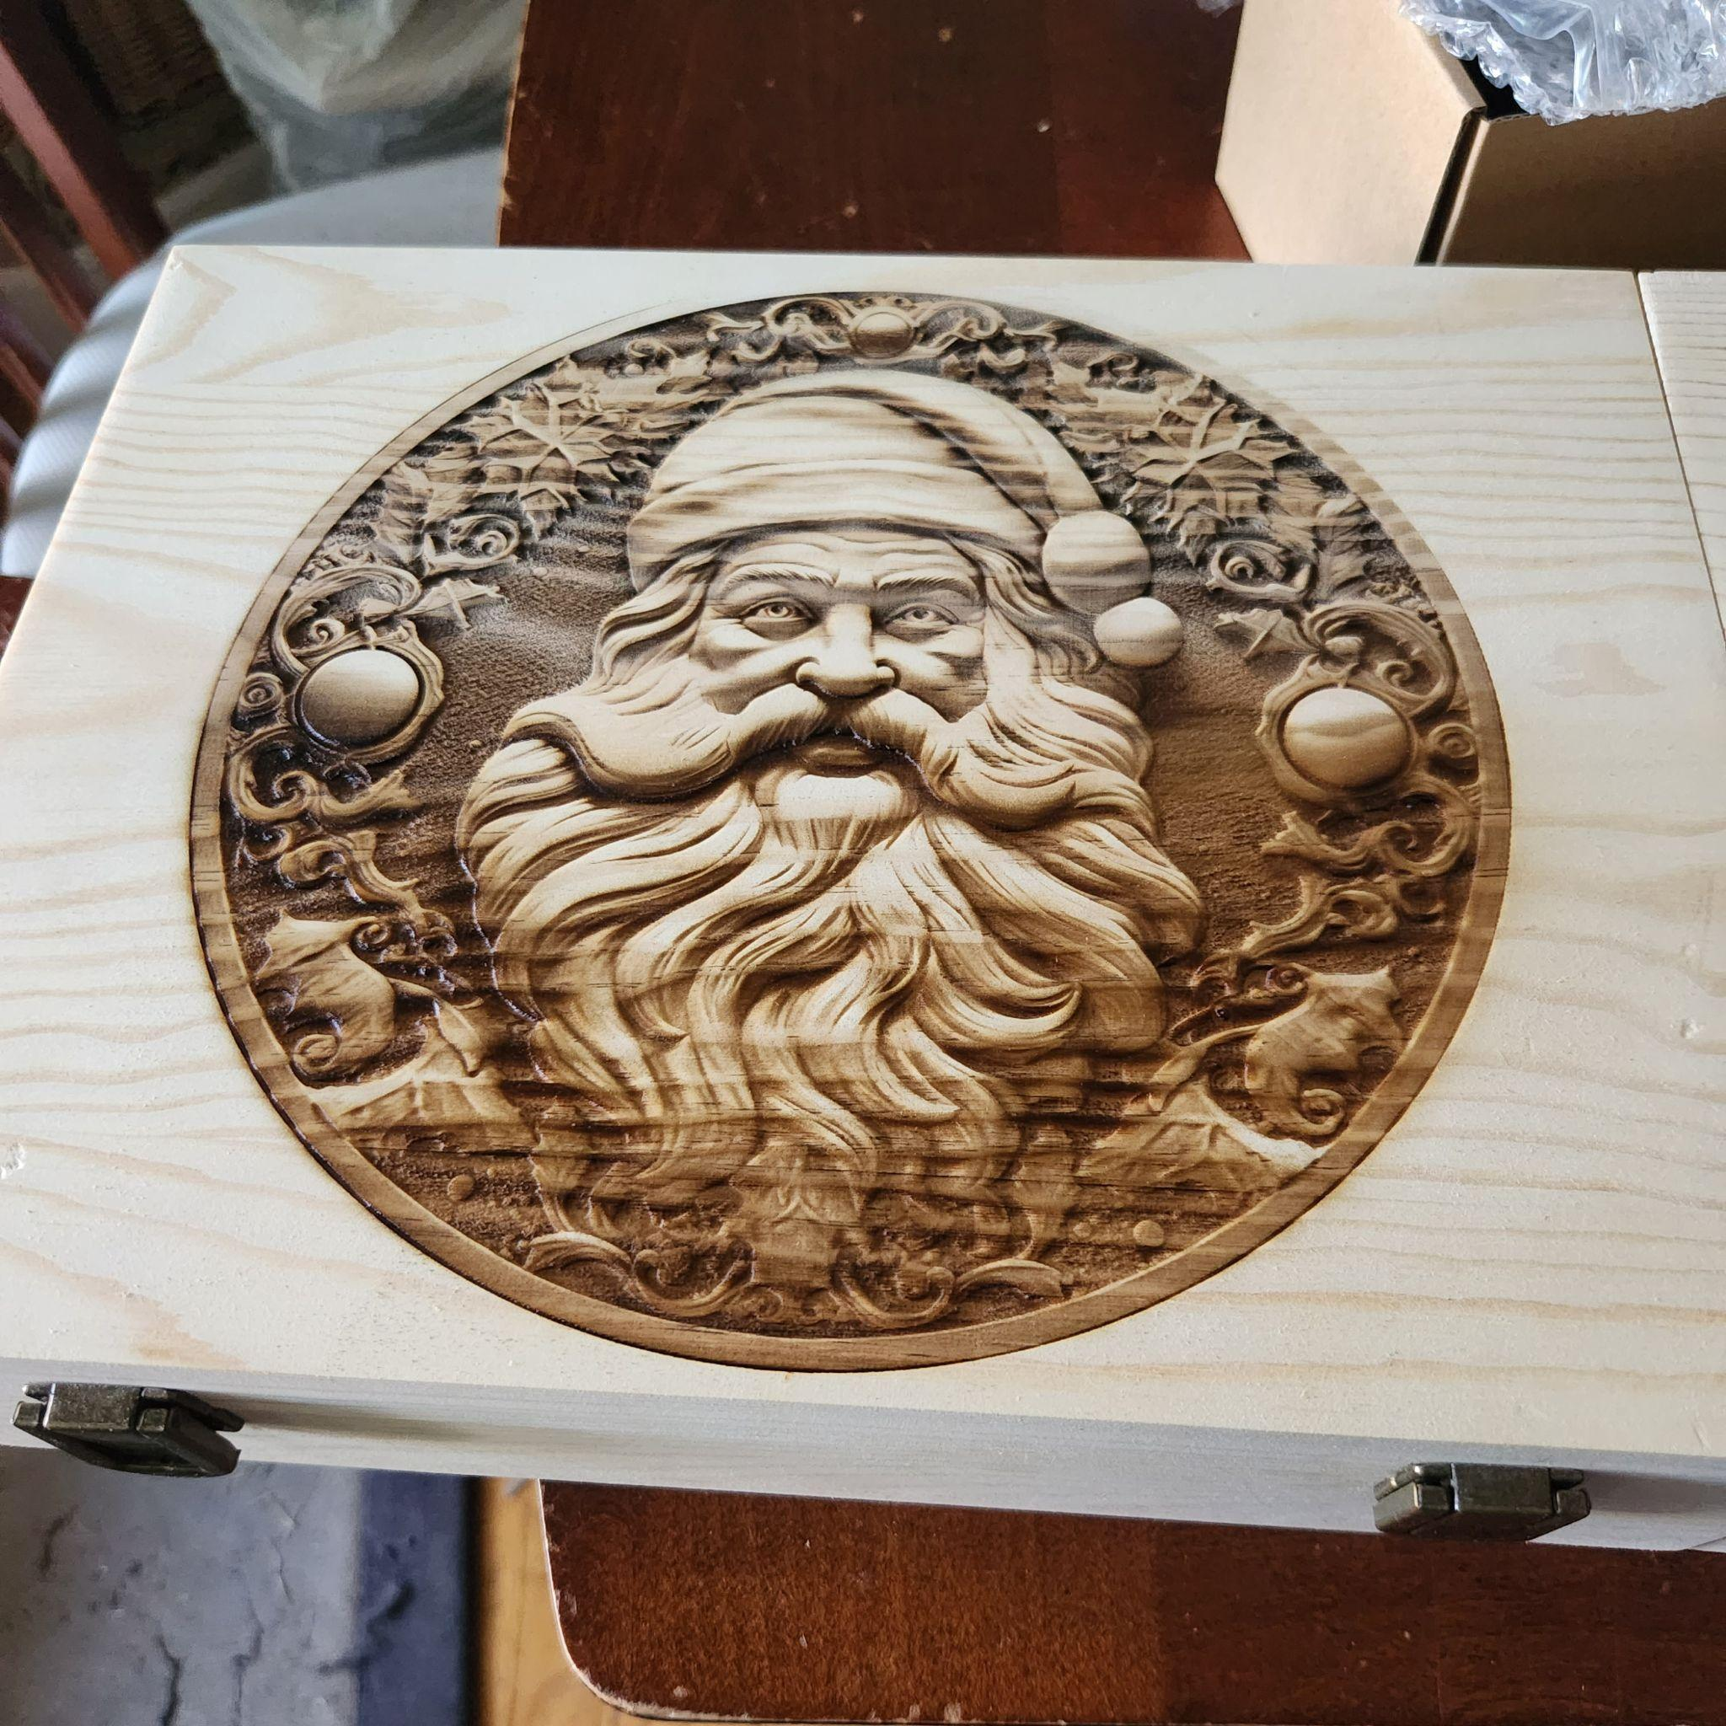
Part 2
Mechanical Assembly
Step 4
Parts Required:
------Your xTool D1 with 20W Upgrade
You’re ready to go make some awesome stuff!

Slide 9
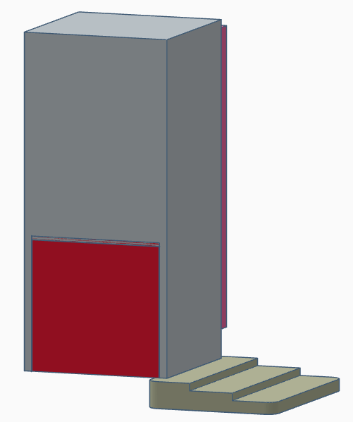
Part 3
Usage Tips
Focusing
Parts Required:
------Your xTool D1 with 20W Upgrade
------Focus Block
Lower your module until the bottom edge just touches the top of the Focus Block.
  This handles materials up to 15mm thick
For materials 15-20mm thick, use the second step of the Focus Block
For materials greater than 20mm thick, use the bottommost step of the Focus Block

Slide 10
Part 3
Usage Tips
Line Interval / DPI / Line per cm
Framing
For some materials, such as wood, engravings may provide a better appearance by lowering the values to account for collateral damage
  0.1 Line Interval
  254 DPI
  100 Lines per cm
Your module does not have an external indicator for use during framing. Instead, use the laser dot itself. The beam will be visible through the front shield of the module.
  Set to 1-5% power for framing
    Some materials are very sensitive and may become marred by framing even with only 1% power
  Be sure to disable any pointer offset previously used

Slide 11
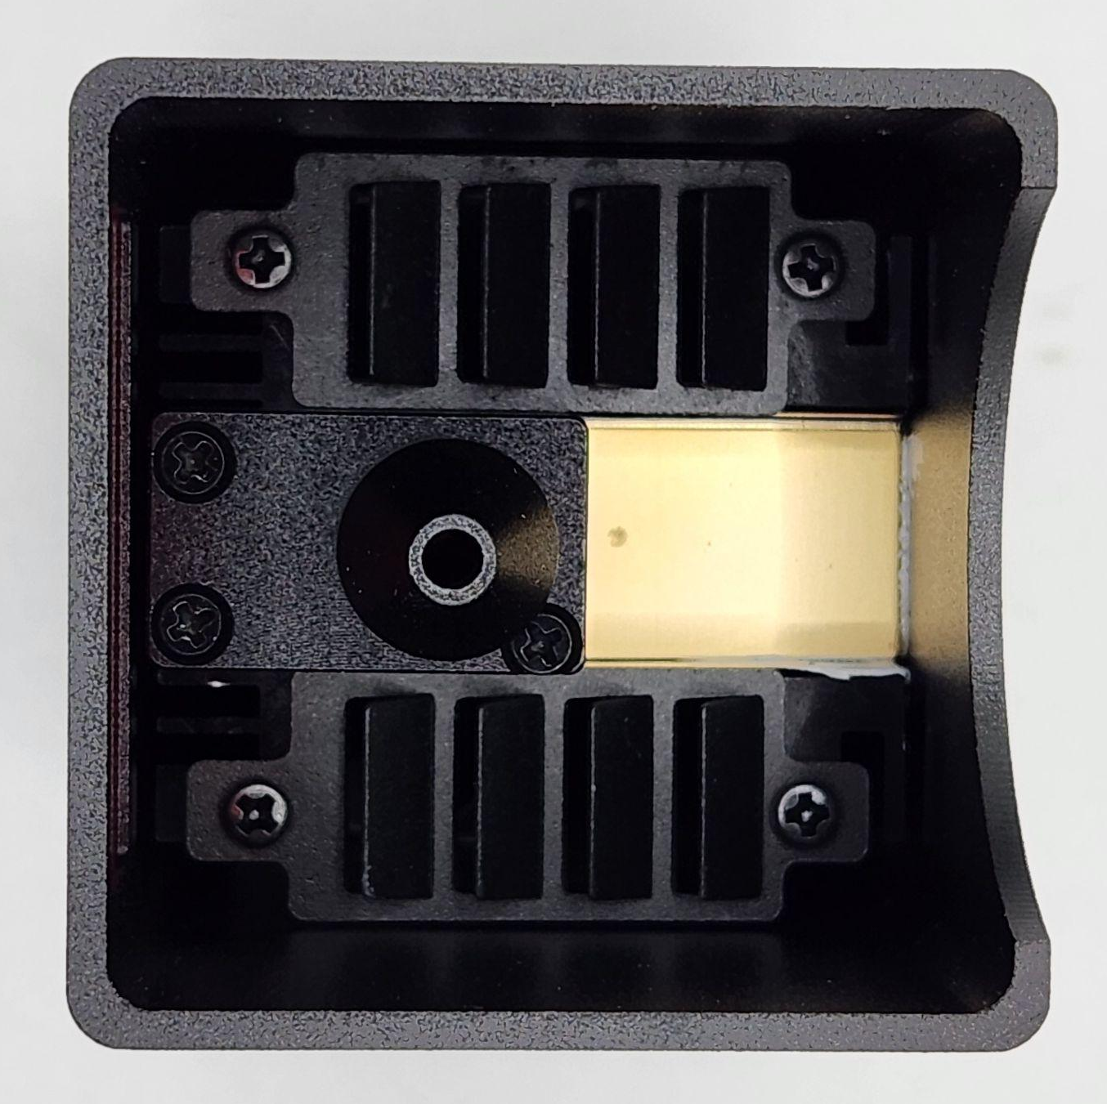
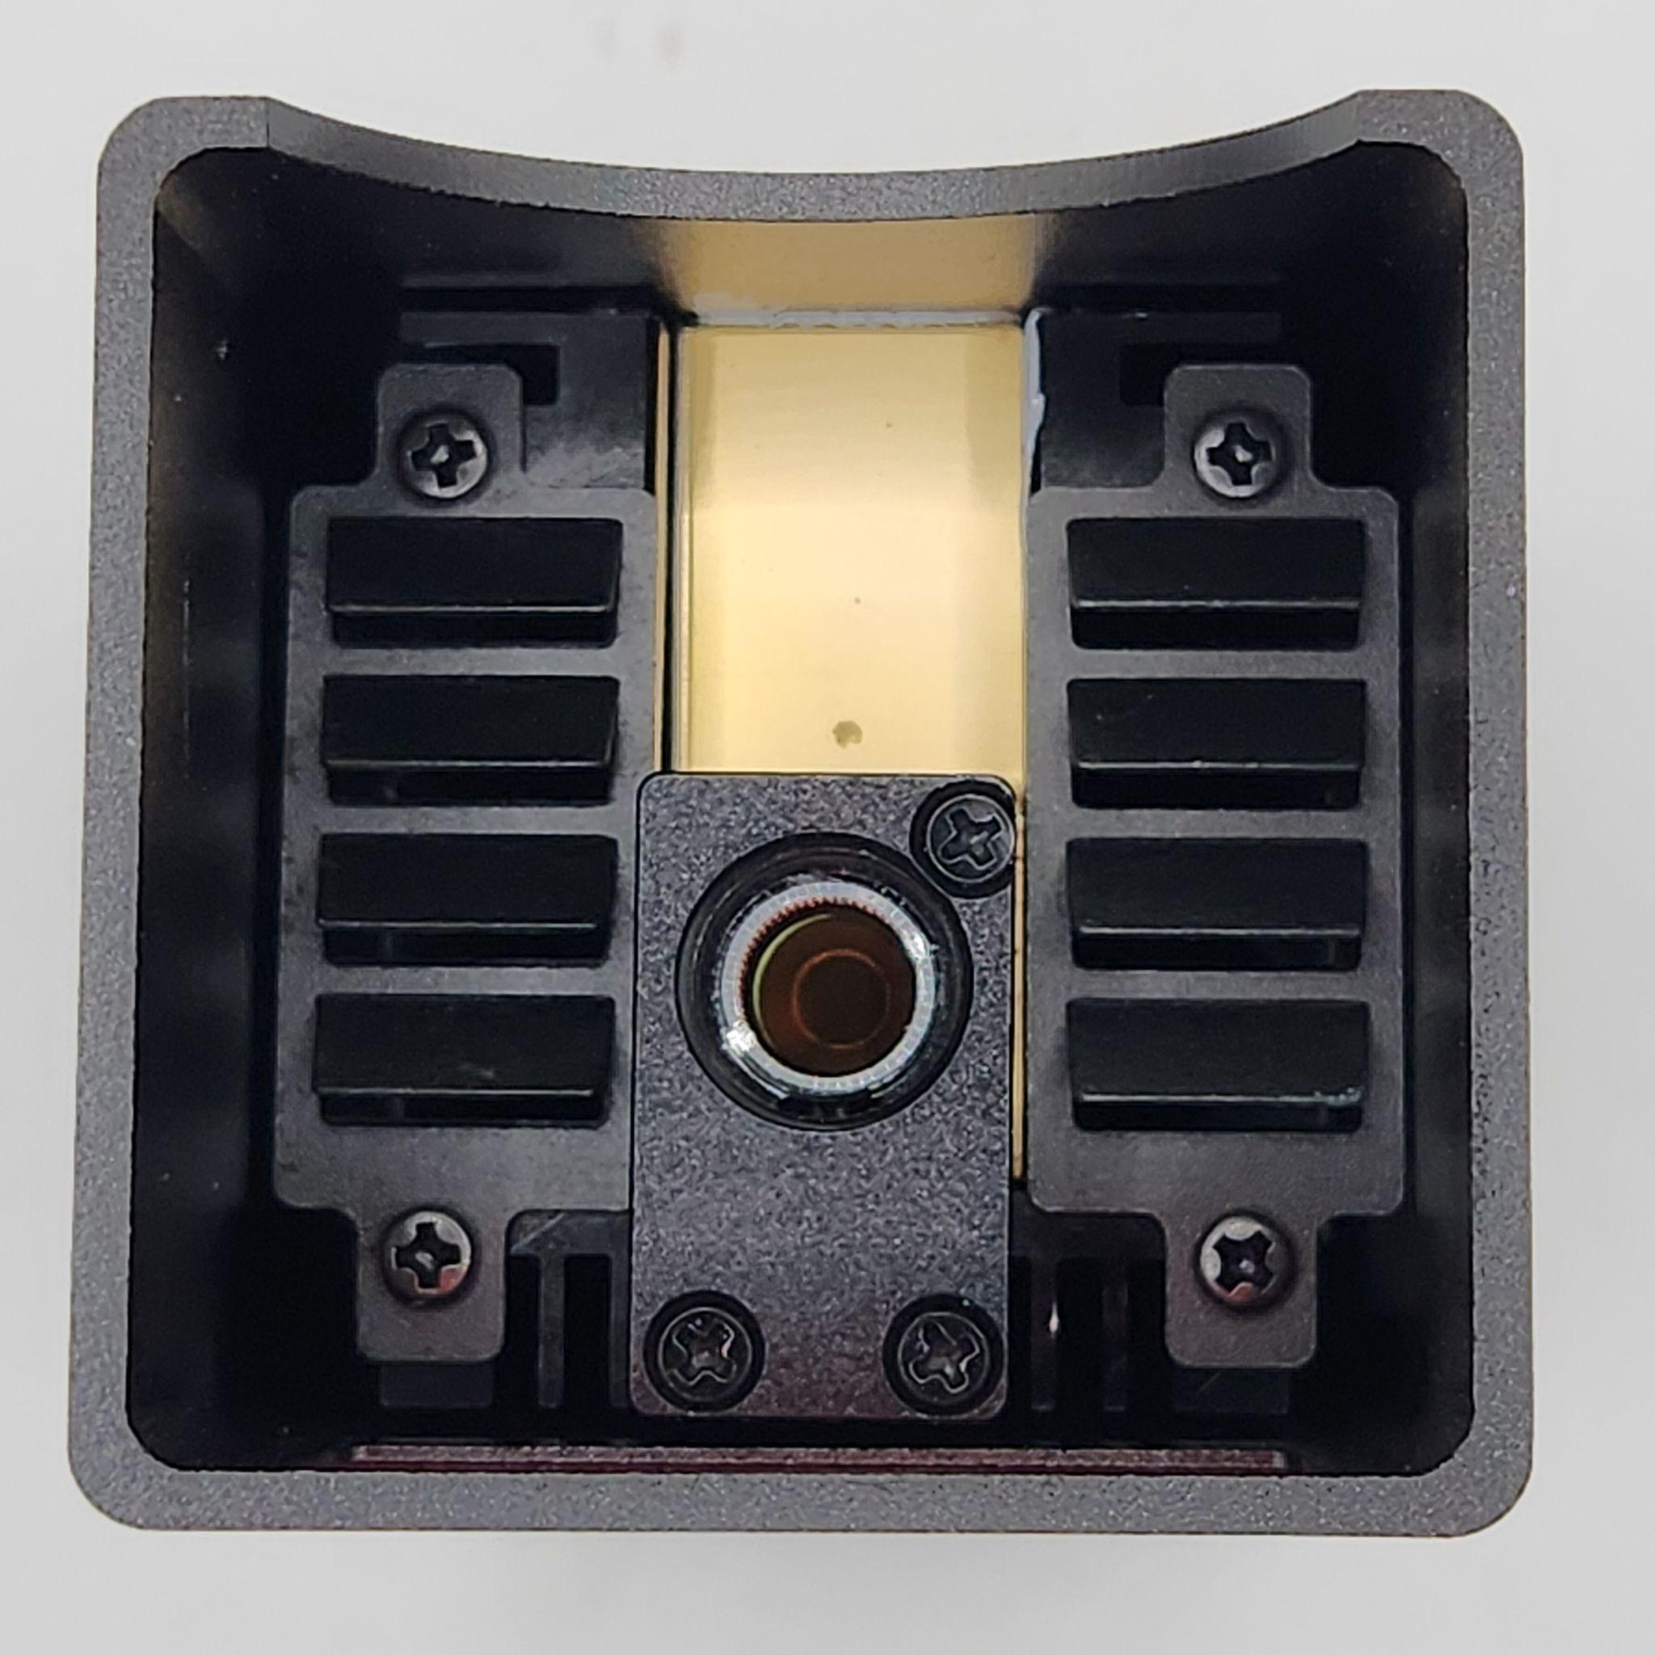
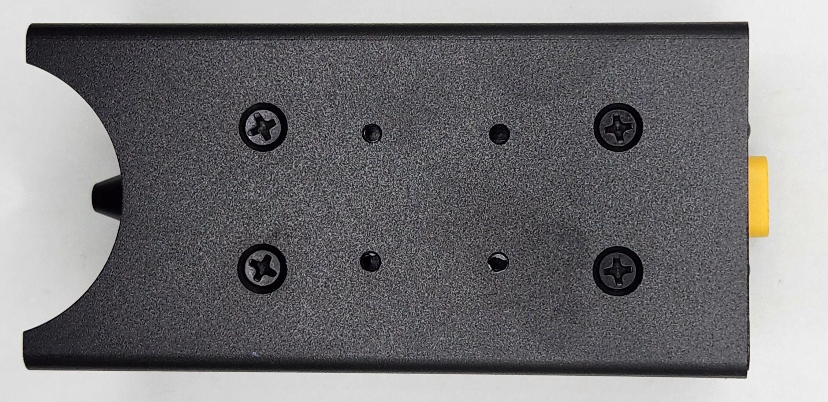
Part 4
Maintenance
Cleaning and Care
To clean the lens cover, unscrew the air assist nozzle. Use rubbing alcohol and cotton swabs, or, lens cleaning swabs, to remove dirt and debris from the lens cover. BE GENTLE
  If lens cover cannot be cleaned or is cracked, it needs to be replaced
To replace the lens cover, insert a medium to large screwdriver into the tabs of the retaining ring and unscrew it. Replace the lens cover with a new one, and reinstall the retaining ring. BE GENTLE
To access the side fans, remove the four screws from the rear of the module The outer cover will slide off.
Your module uses a 8mm lens cover glass. Replacements are available from Geeks At Large (TTS-20/TTS-Pro 20) and other retailers

